Slide 1
Kaggle -
Digit Recognizer -
Group 8
Barnabas Vizy
Zhiwen Luo

Slide 2
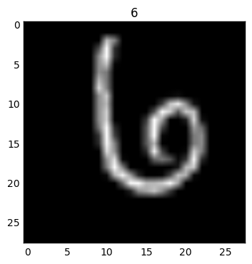
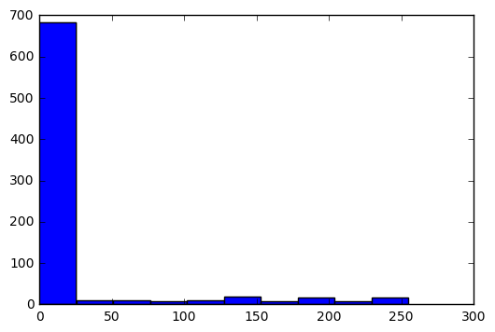
1) data collection and sampling
The data set is a matrix of pixels
Each pixel is in grey scale, so it has a value or 0-255
We must decipher , and pattern match , which numbers these pixels form into
784 pixels per record
The data set is provided on Kaggle, as csv, and labeled as “test” and “train” sample sets
Sampled 5000 records, to reduce overall size during training
Histogram of Pixel Values

Slide 3
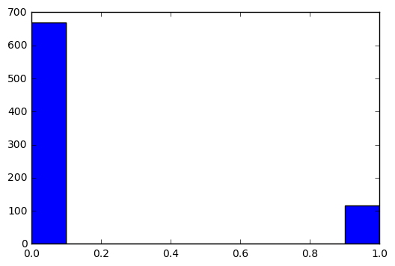
2) preprocessing (data integration, if any, and data normalization)
Using all of values of the pixels offers too much resolution
Take grayscale and convert to black and white , to reduce variability
Resize data into 28,28 NxN matrix rather than 1x784
Original input is 28000x784
We can now quickly sample a training set while holding out 40% of the data for testing (evaluating) our classifier , as shown here with train_size = .4

Slide 4
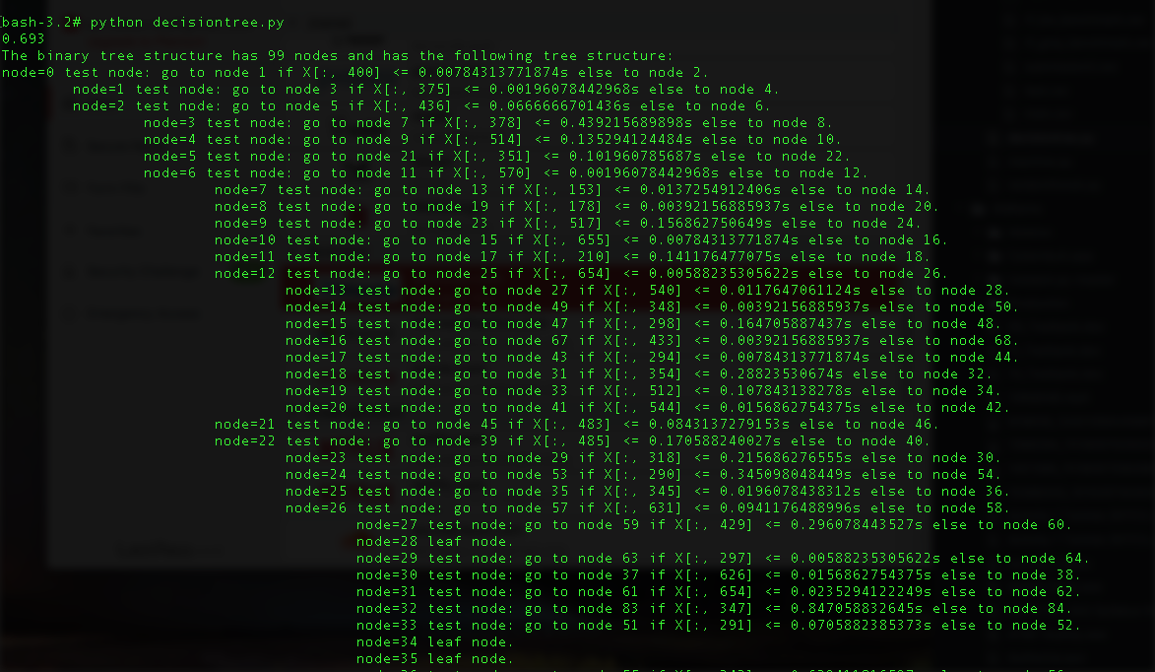
3) Scope
Partial printout of literal decision tree generated by our code.
Our goal is to try multiple classification methods, while also varying their respective fine-tuning, to train the most optimal digit recognizing methodology.
We tried three models from Scikit:
SVM.VCS (Support Vector Machine- Vector Classification)
Randomforest
Decisiontree
Our most effective implementation was
Randomforest

Slide 5
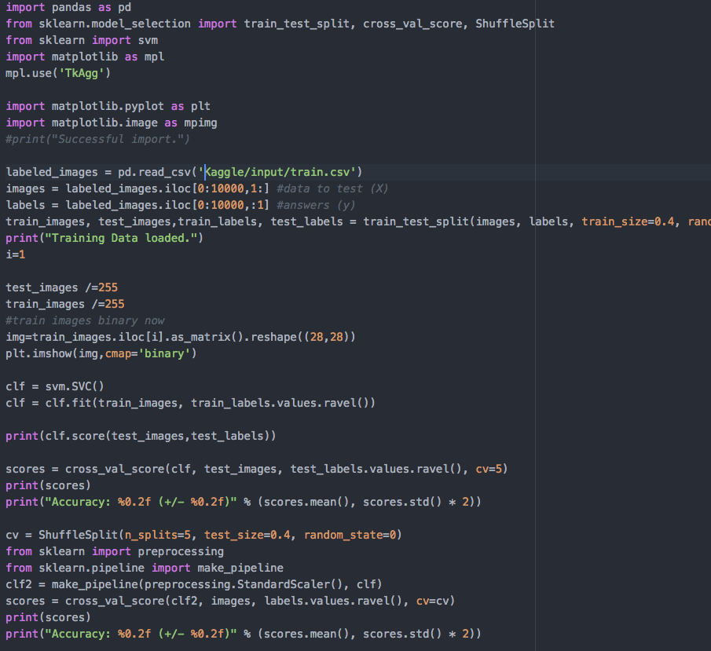
Example Code

Slide 6
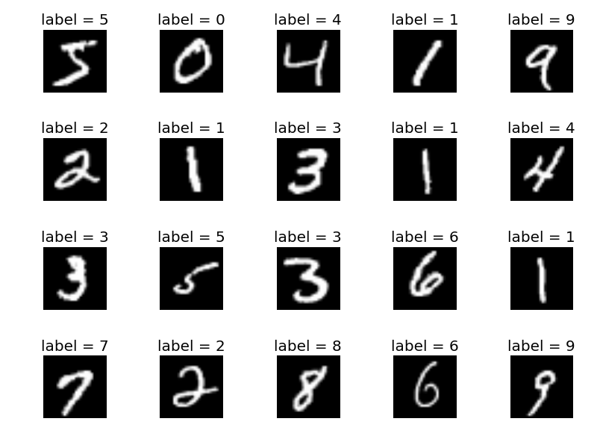
3) Feature Selection / Dimension Reduction
Selecting the features of this data set is tricky because each dimension is a pixel
784 features per record
We can reduce dimensions, but we also simultaneously risk reducing the resolution of the image.
We attempted to apply a basic Principal Component Analysis, to try and project the original features of our data to a reduced dimension, while still trying to keep most of the information.
This proved to be very challenging

Slide 7




5) 5-fold cross validation on different implementations
Here is the cross_val snippet
And the result for Vector Classification, using 5-fold cross Validation: 91% , which is what Kaggle gave us for this (scoring against 28000 test samples)
And the Decisiontree implementation:
Randomforest(our winner), also same as kaggle scoring

Slide 8
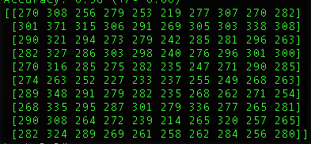
8) results: confusion matrix, precision, recall, and difficulties
Limited by Python Scikit experience and lack of graphical interface
Non normalized

Slide 9
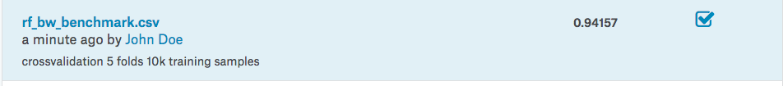
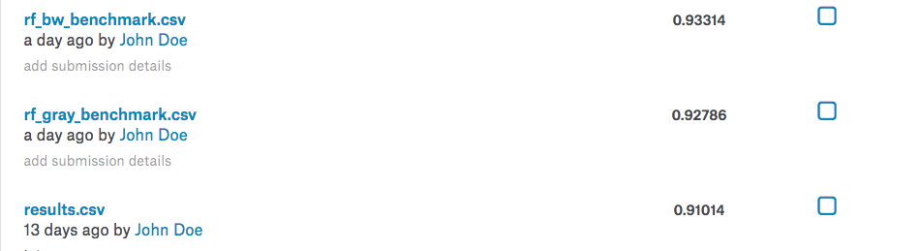
Kaggle Receipt

Slide 10
Conclusion
Randomforest implementation worked best for us
Our implementation was quite rudimentary
Neural Network Required for highest scores
Our results from Kaggle improved with every iteration of our code. Trying different implementations with slightly different parameters for their respective algorithms allowed us to slowly increment our success score. Despite it being .941 score, this is not by any means profound, resting comfortably in the 85% percentile of submissions.

